Slide 1


<Mina Magdy>
| Basic Linux Commands |
Linux Administration
oscp,sscp,ceh,crtp

Slide 2
<Linux Environment> <env>
Linux Environment >>> Variables
Ex1 a = 1 Ex2 b = 2 print (a+b) = 3
All In memory “Ram”
U Can Access To all With shell “Terminal”
Let’s Try with “ls”
Try “which whoami”
echo $PATH

Slide 3
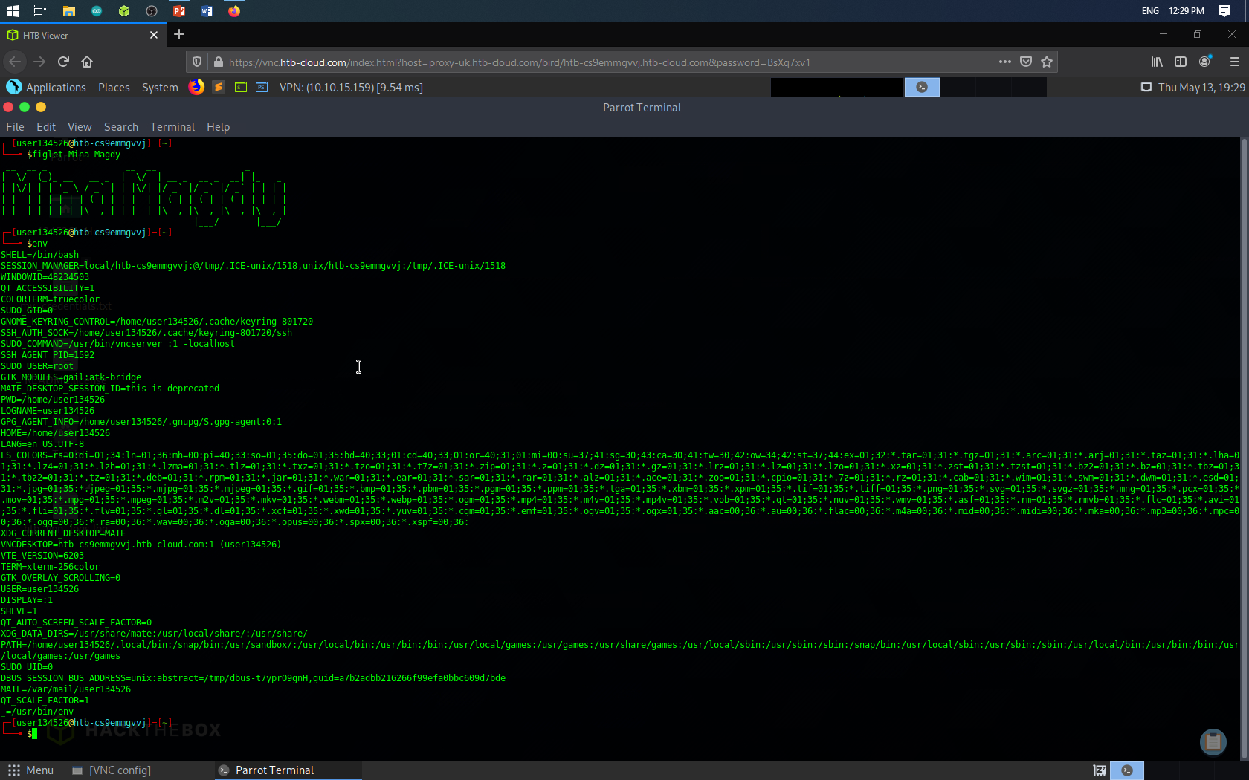

Slide 4
| Basic Linux Commands |
<Part 1>
LINUX UPDATEING
sudo apt update | Connect with Linux servers & show update
sudo apt upgrade | Switch the old bundle to the new one
sudo apt full-upgrade | upgradeing Thems & GUI & Icons
sudo apt apt update | sudo apt full-upgrade 1&2
sudo apt autoremove | Deletion of old files after updating
sudo apt search | earching for a specific package inside the Linux repositories

Slide 5
| Basic Linux Commands |
<Part 2>
FILES & NAVIGATING
ls | List Files
ls –l
ls –al
cd | To move between files | Change Directory
cd DIR NAME
cd ..

Slide 6
| Basic Linux Commands |
<Part 2>
FILES & NAVIGATING
pwd | print word directory
mkdir NEW FILE NAME | make directory
rm dir FILE NAME | delete file
rm –f | fore delete
rm –rf | delete directory file
manually Options
man ls

Slide 7
| Basic Linux Commands |
<Part 2>
FILES & NAVIGATING
tail | show top 10 lines
wc | 18 18 94 M3LOMAT.TXT
<Grep>
gerp, egrep, fgrep, rgrep – print lines that match
cat M3LOMAT.TXT | grep “WORD”
man grep

Slide 8
| Basic Linux Commands |
<Part 2>
FILES & NAVIGATING
cp | copy
cp FILE1 To FILE2
mv | move
mv FILE1 To FILE2 | To Move Files
mv FILE1 To FILEE | To Rename File
touch | Create New text File
cat | To open Text File

Slide 9
| Basic Linux Commands |
<Part 3>
NETWORKING
ping HOST | ping host
whois DNS | get whois for domain
3. dig DNS | get DNS for domain
4. dig –x HOST | reserve lookup host
4. wget FILE | download file
5. wget -r URL | download file from url

Slide 10
| Basic Linux Commands |
<Part 4>
PROCESSES
ps
ps aux
PID
kill PID
Kill all proc
htop & top >> sudo apt install htop
tree >> sudo apt install tree

Slide 11
| Basic Linux Commands |
<Part 5>
SYSTEM INFO
1. date
2. uptime
3. whoami
4. cat /proc/cpuimfo
5. cat /proc/meminfo
6. free
7. du
8. du –sh
9. df
10. df -h

Slide 12
| Basic Linux Commands |
<Part 6>
SYSTEM INFO
<uname>
uname
uname -a | show kernel Version
uname -n | kali
uname -s | Linux
uname -m | x86_64
uname -r | 5.9.0-kali-amd64
man uname | to show more options

Slide 13
| Basic Linux Commands |
<Part 7>
PERMISSIONS
|Permissions|
Every file and directory in your UNIX/Linux system has following 3 permissions defined for all the 3 owners discussed above.
Read -r
Write -w
Execute -x

Slide 14
| Basic Linux Commands |
<Part 7>
PERMISSIONS
1. r = read permission
2. w = write permission
3. x = execute permission
4. - = no permission

Slide 15
| Basic Linux Commands |
<Part 7>
PERMISSIONS
|Permissions|
1. chmod +rwx filename
to add permissions.
2. chmod -rwx directoryname
to remove permissions.
3. chmod +x filename
to allow executable permissions.
4. chmod -wx
filename to take out write and executable permissions.

Slide 16
| Basic Linux Commands |
<Part 7>
PERMISSIONS
|User Denotations|
u | user/owner
g | group
o | other
a | all

Slide 17
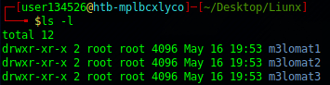
| Basic Linux Commands |
User
Group
Others

Slide 18
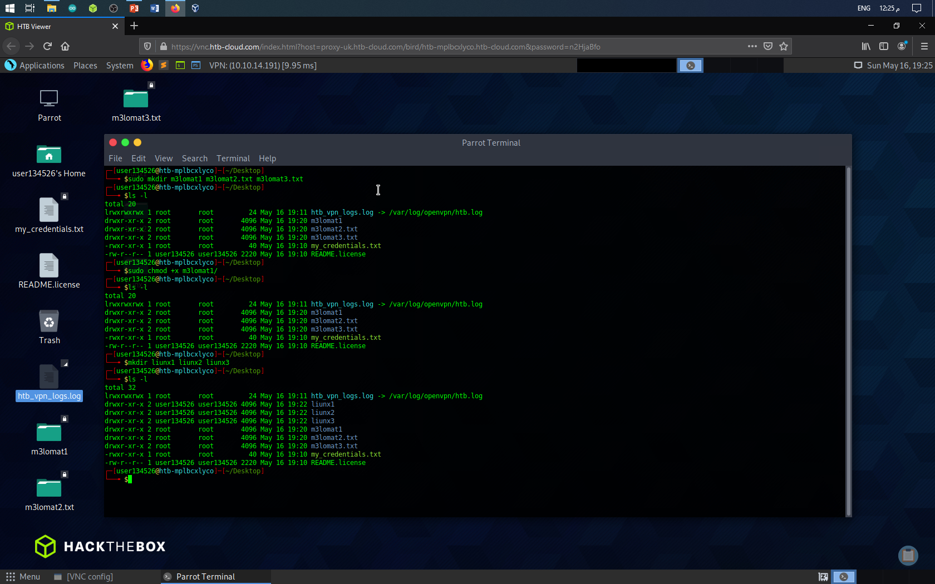

Slide 19
| Basic Linux Commands |
<Part 8>
LIUNX SERVICES
|apatche2|
sudo service apatche2 start | to start apatche service
sudo service apatche2 stop | to stop apatche service
sudo service apatche2 restart| to restart apatche service
sudo service apatche2 statues | show apatche statues
To Downloading file http://192.168.1.5/m3lomat1.txt

Slide 20
| Basic Linux Commands |
<Part 8>
LIUNX SERVICES
|SSH|
1. ssh user@host | connect to host as user
2. ssh –p port user@host | connect using P
3. ssh –D user@host | connect & use bind P

Slide 21
| Basic Linux Commands |
<Part 8>
LIUNX SERVICES
|FTP|
ftp DNS.com | Domain Name System
ftp IP | Internet Protocol
ftp USER@FTPDOMAIN.COM
FILES MANAGE
cd DIR
lcd /home/user/urdirectoryname|Downloading files with FTP
get FILE | Download file

Slide 22
|Final Result|
Linux “ENV”
Part 1 | Linux Updating and differences on upgrading
Part 2 | Files & Navigating
Part 3 | Networking
Part 4 | Process
Part 5 | System info
Part 7 | Permitions
Part 8 | Linux Services

Slide 23
ASKING TIME ??

Slide 24
You can Ask Me ON ?
Facebook : https://www.facebook.com/m3lomatthephone
My YouTube Chanel : https://www.youtube.com/c/m3lomatthephone
M3lomat the phone 2 : https://www.youtube.com/channel/UCixopZbFBzdYKk2qsZLsRCA
M3lomat Electric : https://www.youtube.com/channel/UCGnXhX2E_MaGYOY8kyOowbQ
Instagram : https://instagram.com/mena.m.rushdy?igshid=1xg5sxvjtek7i
LinkedIn : https://www.linkedin.com/in/mina-magdy-38362b1b6/
Facebook Group : https://www.facebook.com/groups/391033085092937

